Slide 1
Model
Evaluation
Shahriar’s Analytical Academy

Slide 2
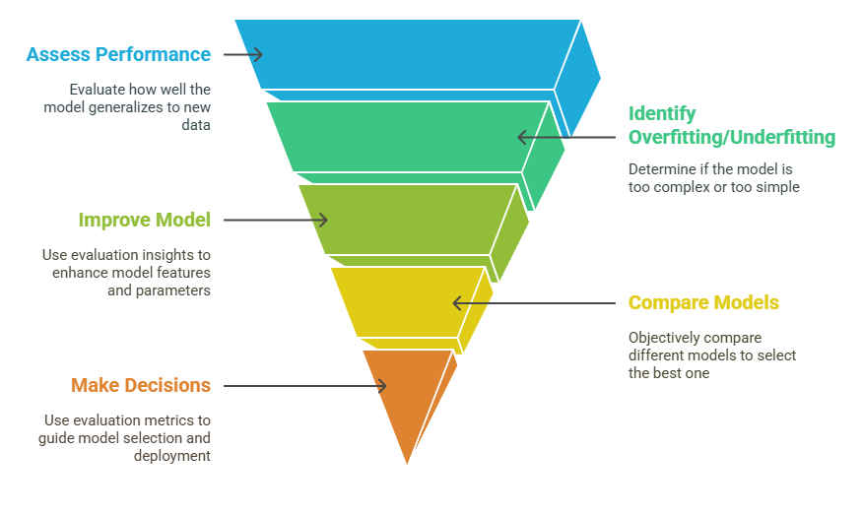
Model Evaluation
Model Evaluation refers to the process of assessing how well a trained machine learning model performs on unseen data. It involves determining the accuracy and reliability of the model's predictions and helps to identify potential issues such as overfitting, underfitting, or bias.
Notes:
Definition of Model Evaluation: Model evaluation is the process of assessing how well a machine learning model performs on data it hasn’t seen before. This step is essential in determining the accuracy and reliability of a model's predictions. It helps in identifying areas for improvement, such as overfitting (where the model is too specific to the training data) or underfitting (where the model is too simple to capture the underlying data patterns). Evaluation metrics help to gauge how well the model can generalize to new data and make accurate predictions.
Why Model Evaluation Is Necessary?
Performance Assessment: Model evaluation is crucial for understanding how well a trained model can make predictions on new, unseen data. During training, the model learns from existing data, but the ultimate goal is to make predictions on data that it hasn't encountered before. Identifying Overfitting/Underfitting: Model evaluation helps in identifying whether a model suffers from overfitting or underfitting:
Overfitting occurs when the model learns too much from the training data, capturing noise or irrelevant patterns, and thus fails to generalize to new data. This leads to excellent performance on the training set but poor performance on unseen data.
Underfitting occurs when the model is too simplistic and cannot capture the patterns in the data, leading to poor performance on both training and unseen data. Evaluating the model using different metrics and datasets helps identify and correct these issues by adjusting the model's complexity or improving the data.
Improving the Model: Evaluation results provide valuable feedback for model improvement. If the model is underperforming, the evaluation metrics will highlight which areas need attention. For instance, feature engineering might be necessary to better represent the data or the model’s hyperparameters might need to be tuned for better accuracy. Objective Comparison: Evaluating multiple models allows you to compare their performance in a systematic and objective manner. By using consistent evaluation metrics, you can select the best-performing model for your specific task
Decision Making: Evaluation metrics are essential for making informed decisions about model selection, deployment, and future iterations. Based on the evaluation, you can decide which model to deploy in production or which areas to focus on for further development

Slide 3
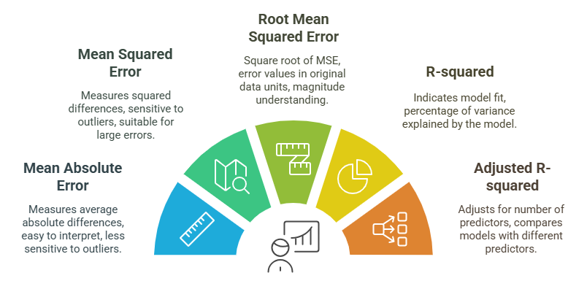
Model evaluating metrics - Regression
Notes:
1. Mean Absolute Error (MAE):
Definition: MAE is the average of the absolute differences between the predicted values and the actual values. It is calculated by summing the absolute errors and dividing by the number of data points.
Interpretation: MAE provides an easily understandable measure of error by showing the average magnitude of errors in the model’s predictions. Since it takes the absolute difference, it is less sensitive to large errors or outliers, making it a more robust measure when there are some extreme values in the dataset.
Use Case: MAE is useful when you want an intuitive measure of average prediction error that does not disproportionately penalize large errors. It’s often used in situations where large errors are less critical, such as estimating average sales in a business.
2. Mean Squared Error (MSE):
Definition: MSE is the average of the squared differences between predicted values and actual values. It is calculated by squaring the errors (differences between predicted and actual values), summing them, and then dividing by the number of data points.
Interpretation: MSE is more sensitive to outliers than MAE. By squaring the errors, larger errors are penalized more heavily. This makes MSE particularly useful when large errors are undesirable or have a significant impact on the model's performance.
Use Case: MSE is often used in cases where larger errors are particularly costly, such as in medical predictions or financial forecasting. It helps to focus the model on minimizing large prediction errors.
3. Root Mean Squared Error (RMSE):
Definition: RMSE is the square root of the Mean Squared Error. It provides error values in the same unit as the original data, making it easier to interpret compared to MSE.
Interpretation: RMSE is a more intuitive measure because the error is presented in the same scale as the dependent variable. Like MSE, RMSE penalizes larger errors more than smaller ones, but the square root transformation makes the metric easier to relate to real-world data.
Use Case: RMSE is often used when you need a metric that reflects the actual magnitude of prediction errors. For example, in a weather prediction model, the RMSE would represent the average magnitude of the prediction error in degrees, making it easier to interpret by meteorologists.
4. R-squared (Coefficient of Determination):
Definition: R-squared is a statistical measure that represents the proportion of the variance in the dependent variable that is explained by the independent variables in the model. It is a percentage that ranges from 0 to 100% (0 to 1 in decimal form).
Interpretation: An R-squared value closer to 1 indicates that the model explains a large portion of the variance in the data, meaning the model fits the data well. An R-squared value closer to 0 indicates a poor fit, where the model explains little of the variance. R-squared tells us how well the model captures the variability of the data but does not directly measure the model's accuracy in predicting new, unseen data.
Use Case: R-squared is useful when you want to understand how well the independent variables in the model explain the variability in the dependent variable. It is commonly used in linear regression models for explaining the proportion of variation accounted for by the model.
5. Adjusted R-squared:
Definition: Adjusted R-squared is a modified version of R-squared that adjusts for the number of predictors (independent variables) in the model. Unlike R-squared, which always increases as more variables are added, Adjusted R-squared penalizes the addition of unnecessary predictors that don’t improve the model.
Interpretation: Adjusted R-squared is useful for comparing models with different numbers of predictors. A higher Adjusted R-squared indicates a better model that explains the variability with a more efficient use of predictors. Unlike R-squared, which can be misleading when comparing models with different numbers of variables, Adjusted R-squared provides a more realistic measure.
Use Case: Adjusted R-squared is particularly useful when comparing multiple models, especially in cases where adding more variables may not improve the model’s predictive power but could lead to overfitting. It helps in model selection when considering the complexity of the model and its predictive ability.

Slide 4
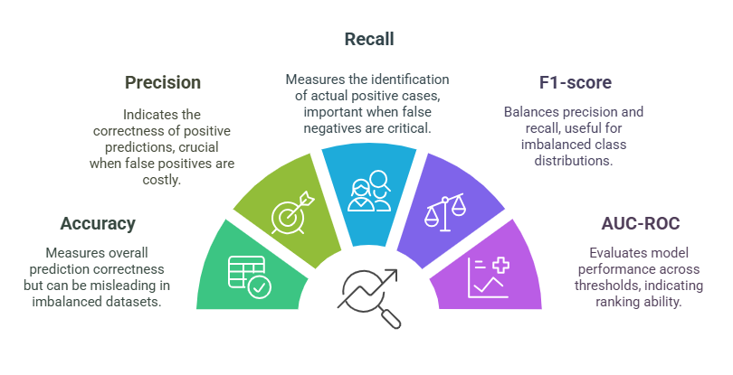
Model evaluating metrics - Classification
Notes:
Definition: Accuracy measures the proportion of correct predictions (both positive and negative) made by the model out of all prediction.
Interpretation: Accuracy provides a simple and straightforward measure of model performance, but it can be misleading, especially in imbalanced datasets. For example, if you have a dataset where 90% of the data belongs to one class (say, negatives) and only 10% to the other (positives), a model that predicts all instances as the majority class would still have high accuracy (90%), even though it completely fails to predict the minority class. Hence, accuracy alone is not always the best indicator.
Use Case: Accuracy is useful in balanced datasets where both classes are equally represented. For imbalanced datasets, it’s better to consider other metrics, such as precision or recall.
2. Precision:
Definition: Precision measures the proportion of true positive predictions out of all positive predictions made by the model
Interpretation: Precision tells you how accurate the positive predictions are. It is crucial when false positives (predicting positive when the actual class is negative) are costly or undesirable. For example, in medical diagnostics, falsely diagnosing a healthy patient as sick (false positive) may lead to unnecessary treatments.
Use Case: Precision is particularly important in applications such as spam email detection, fraud detection, or medical testing, where false positives can have significant consequences.
3. Recall (Sensitivity):
Definition: Recall measures the proportion of actual positive cases that were correctly identified by the models
​ Interpretation: Recall tells you how well the model identifies positive instances. High recall means that most actual positives are identified by the model. It is critical when false negatives (failing to identify a positive instance) are more detrimental. For instance, in disease diagnosis, missing a positive case (false negative) could have severe consequences.
Use Case: Recall is particularly important in applications like cancer detection, fraud detection, or any domain where missing a positive case (false negative) could lead to serious consequences.
4. F1-score:
Definition: The F1-score is the harmonic mean of precision and recall. It combines both metrics into a single value that balances the trade-off between precision and recall.
​Interpretation: The F1-score is useful when you have an imbalanced dataset, where one class is much more frequent than the other. It balances precision and recall, ensuring that neither is overlooked. A high F1-score indicates that both precision and recall are reasonably high, making it a more comprehensive evaluation metric than accuracy in these cases.
Use Case: F1-score is used when there is a need to balance the importance of precision and recall, especially in scenarios where the dataset is imbalanced. It’s widely used in applications like fraud detection, information retrieval, and classification tasks in healthcare.
5. AUC-ROC (Area Under the Curve - Receiver Operating Characteristic):
Definition: AUC-ROC measures the performance of a classification model across all classification thresholds. The Receiver Operating Characteristic (ROC) curve plots the true positive rate (sensitivity) against the false positive rate (1 - specificity). The Area Under the Curve (AUC) quantifies the overall ability of the model to discriminate between positive and negative classes.
Interpretation:
An AUC of 1 means the model perfectly classifies all positive and negative instances.
An AUC of 0.5 means the model performs no better than random chance.
An AUC greater than 0.5 indicates that the model is able to distinguish between positive and negative instances with some degree of success.
Use Case: AUC-ROC is useful when you want to evaluate the performance of the model across different thresholds and when dealing with imbalanced datasets. It is particularly helpful when you are interested in the model's ability to rank positive instances higher than negative ones, regardless of the specific classification threshold.

Slide 5
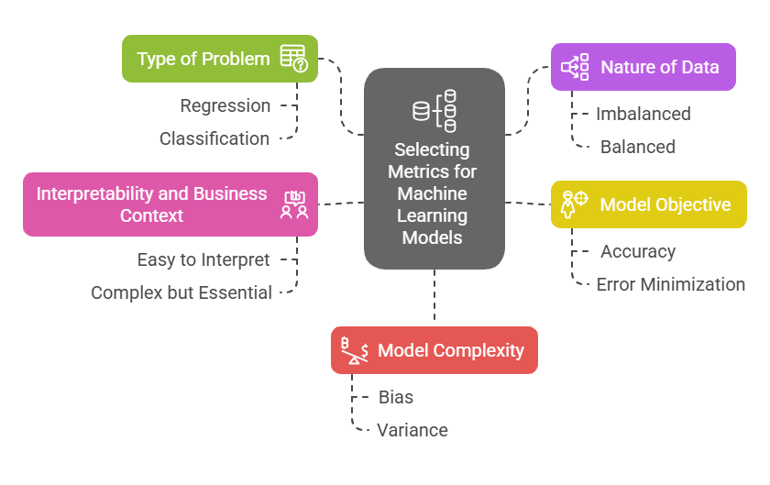
Key Factors to Consider
Notes:
When selecting the right evaluation metrics for a machine learning model, several factors must be considered to ensure that the chosen metric aligns with the type of problem, the nature of the data, and the specific goals of the model. Below are the key factors to keep in mind:
1. Type of Problem (Regression or Classification):
Regression Problems:
When dealing with regression tasks, where the model predicts continuous output, the evaluation metrics should measure how well the model predicts those continuous values. Common metrics for regression include:
Mean Squared Error (MSE): Measures the average squared difference between predicted and actual values.
R-squared: Indicates how well the model explains the variance in the dependent variable.
Classification Problems:
For classification tasks, where the goal is to predict discrete categories or classes (e.g., spam vs. not spam), the metrics should assess how well the model discriminates between different classes. Common metrics for classification include:
Accuracy: Measures the proportion of correctly predicted instances.
Precision, Recall, and F1-score: More informative for imbalanced datasets or when the cost of false positives or false negatives is significant.
AUC-ROC: Evaluates the model’s ability to rank positive instances higher than negative ones, regardless of threshold.
2. Nature of Data (Imbalanced or Balanced):
Imbalanced Data:
In cases where one class is underrepresented (e.g., fraud detection, rare disease detection), metrics like precision, recall, F1-score, and AUC-ROC become more informative. These metrics focus on how well the model detects the minority class, which is often the primary objective in imbalanced data scenarios.
Balanced Data:
For balanced datasets, where the classes are represented equally, traditional metrics like accuracy might suffice, as the model is expected to perform equally well across both classes. However, precision and recall might still be important in cases where the relative importance of false positives and false negatives differs.
3. Model Objective:
Accuracy-Focused Models:
If the primary goal is to predict values or classes correctly, metrics like accuracy (for classification) or MSE (for regression) will be important. These metrics focus on the overall prediction performance and ensure the model is correct most of the time.
Error Minimization:
If the model's goal is to minimize errors (e.g., in applications where large errors are particularly costly), metrics like MSE or RMSE (Root Mean Squared Error) will be more relevant. These metrics provide insight into how well the model is reducing prediction errors, with RMSE offering a clearer understanding by expressing errors in the same units as the target variable.
4. Interpretability and Business Context:
Interpretability:
Some metrics are easier to explain and interpret, such as accuracy. These metrics may be more useful when presenting the model’s performance to business stakeholders or non-technical users.
Business Context:
In business scenarios, understanding precision, recall, and F1-score might be necessary, especially if the model needs to handle rare events or minimize the risk of missing crucial instances (false negatives). For example, in fraud detection, a higher recall is often preferred over accuracy to ensure most fraud cases are detected.
Metrics like F1-score are especially valuable in cases where both precision and recall matter, such as in customer churn prediction, where it's important to balance both false positives and false negatives.
5. Model Complexity:
Complex Models:
For more complex models (e.g., deep learning models), it's important to evaluate how well they generalize to unseen data, avoiding overfitting or underfitting. Metrics such as cross-validation scores, R-squared, and AUC-ROC provide a better understanding of model performance across multiple data subsets and help in regularization and tuning.
Bias vs. Variance:
When working with models that may suffer from high bias (underfitting) or high variance (overfitting), the choice of metrics can inform decisions about regularization and model tuning. For instance, using RMSE alongside R-squared can highlight issues in prediction error and the model’s fit to the data. This helps in adjusting the complexity of the model to achieve an optimal balance between bias and variance.

Slide 6
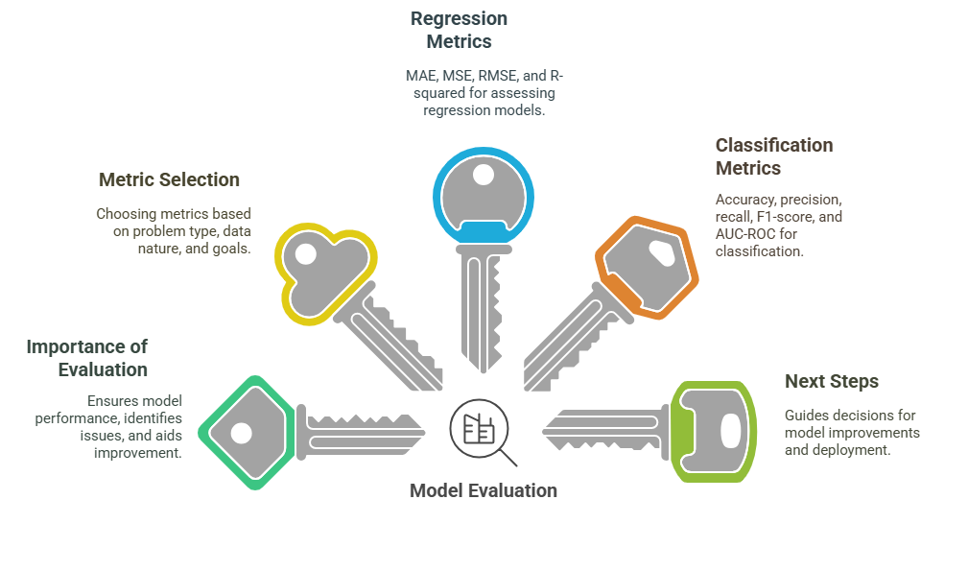
5 Key Learning Points of this Lesson
Notes:
Importance of Model Evaluation:
Evaluating models ensures they perform well on unseen data, identifies potential problems like overfitting, and helps improve the model.
Choosing the Right Evaluation Metric:
The selection of evaluation metrics should be based on the problem type (regression vs. classification), data nature (imbalanced vs. balanced), and model goals.
Key Regression Metrics:
MAE, MSE, RMSE, and R-squared are crucial for assessing regression models. Understanding their pros and cons helps select the most appropriate one for specific use cases.
Key Classification Metrics:
Metrics like accuracy, precision, recall, F1-score, and AUC-ROC are essential for evaluating classification models, especially in imbalanced datasets.
Model Evaluation Guides Next Steps:
Model evaluation results help in making critical decisions for model improvements, deployment, and practical implementation in real-world scenarios.

Slide 7
Thank You!
Shahriar’s Analytical Academy

